Slide 1
How 2026 Could Decide the Future of Artificial Intelligence
Week of January 19
Elias Hord

Slide 2
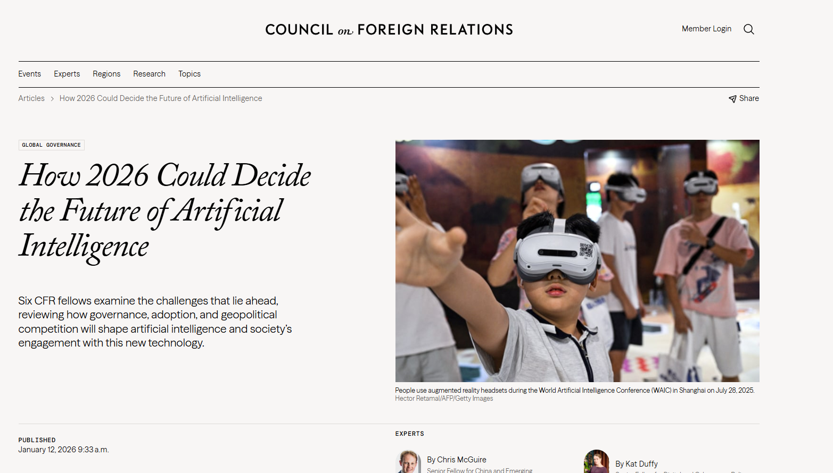
General Information
Article Publication: January 12, 2026
https://www.cfr.org/articles/how-2026-could-decide-future-artificial-intelligence

Slide 3
Main Findings and Arguments
AI Is Entering a Decisive Phase
The article argues that 2026 will mark a transition from speculative debate to real-world impact of AI technologies as systems move from research projects into widespread deployment. Policy and governance decisions made this year will have lasting effects on how AI is used and regulated globally
Geopolitical Competition, Especially U.S.–China
A central theme is the strategic competition between the United States and China for leadership in AI capabilities, market influence, and standards setting. Export controls on chips and access to advanced computing infrastructure remain key policy battlegrounds.
Governance and Regulation Challenges
Governments are moving from drafting rules to enforcing them. In 2026:
The EU’s AI Act takes full effect with significant penalties; China’s Cybersecurity Law now explicitly includes AI oversight; U.S. states begin mandating disclosures and transparency for AI-driven decisions.
Beyond enforcement, there’s growing debate about the legal and philosophical status of AI systems—e.g., whether highly autonomous agents should have legal responsibilities or rights.
Trust and Security (“AI Trust Gap”)
A key operational challenge is lack of visibility into autonomous AI behavior, digital identities, and AI-generated code (“shadow autonomy,” “shadow identities,” “shadow code”). This trust gap undermines adoption and creates security vulnerabilities, particularly in critical systems.
AI Adoption Over Breakthroughs
Instead of a dramatic breakthrough event (like sociopathic superintelligence), the real change in 2026 will be widespread adoption of AI across business, government, and defense—similar to the transformative roles of electricity or the combustion engine.
Multidimensional “AI Competition”
The article rejects a simplistic “race” metaphor. U.S.–China competition spans multiple domains (frontier innovation, adoption in national security, and shaping global norms), and success will depend on versatility and strategy rather than speed alone.

Slide 4
Broader Implications for Society
Economic and Labor Impact
AI adoption could disrupt labor markets, particularly entry-level “knowledge work,” potentially increasing unemployment in some sectors while boosting overall productivity. Policymakers will face growing pressure to address workforce transitions and social safety nets.
Governance and Legal Systems
The transition to enforced regulation will test governments’ capacity to manage technological change. Questions about who is responsible for AI actions, how to protect rights, and how to regulate autonomous agents legally will increasingly enter domestic politics and litigation.
Security and Trust in Institutions
The proliferation of opaque AI systems—especially those making autonomous decisions or generating code—creates blind spots in cybersecurity. Without enhanced visibility and governance, organizations may delay beneficial AI use due to trust issues, slowing economic and institutional modernization.
Global Order and Norms
Differing national approaches (e.g., state-centric control in China vs. rights-based frameworks in the EU) risk fragmenting the global AI environment. Countries with more permissive or efficient regulatory regimes may attract talent and investment, shaping global economic and technological hierarchies.

Slide 5
Relevance or Potential Influence on the Construction Industry
AI Adoption for Project Planning & Automation
As AI adoption accelerates in 2026, construction firms could use AI agents for design optimization, project scheduling, supply-chain coordination, and risk analysis—similar to how businesses and government agencies in other sectors integrate AI into core workflows.
Workforce Transformation
The sector’s workforce could see shifts due to AI tools taking on tasks like drafting reports, analyzing site data, or monitoring safety compliance. This parallels broader labor disruptions noted in the article and may require retraining and new skill development.
Regulatory and Safety Considerations
As governments enforce AI regulations, construction companies deploying AI for critical decisions (e.g., structural design, safety monitoring) will need to comply with transparency and accountability laws emerging in the U.S. and abroad.
Cybersecurity & Trust Issues
The “trust gap” in AI systems is especially pertinent where autonomous systems collect and act on sensitive data (e.g., site monitoring, equipment control). Construction firms must prioritize secure AI governance to prevent breaches and ensure operational continuity.

